Slide 1
Step 1: organize your notes and interpretations
What did we see?
What did we learn?
What are we going to do about it?
Type notes here
Type notes here
Type notes here

Slide 2
Step 2: develop the empathy map (one for each person you interview)
  Synopsis of approach
  A structured, simple but rich way to summarize your findings from a user interview
  Uses five areas to help you build empathy for the user you have interviewed
  A team will create one empathy map for each user they interview. They will then share their findings in a group, identifying patterns of needs represented by multiple users.
  Client context
  KSFs
  Wants to gain empathy for a group of users
  Needs to identify the wants and needs of a user group and use these insights to create a point of view to guide the project
  May have biases / beliefs about what the user needs, but recognize that research may prove that “real life is different than we thought”
  Based on detailed and deep ethnographic interviews and observations
  Clear distinctions between facts and interpretations
  Range of users interviewed – data will come from a large pool of interviewees
  Should be based on real users, not personas

Slide 3
Empathy map
Participants
Process overview
Research team
Client team (this framework is valuable to clients that are new to research)
Conduct interviews, fill out an empathy map for each user interviewed. There are four areas to fill out:
What are they thinking?
Enter three to five statements that summarize what people are thinking about an activity. These statements require you to do some interpretation. It can be hard to determine exactly what people are thinking. The best way to write these statements is to imagine their internal dialog – what are they saying to themselves as they prepare for and engage in this activity. These statements are often more personal and less confident than what they are saying out loud.
What are they feeling?
Enter three to five statements that summarize how people are feeling during the activity. Again, these statements require some interpretation. You can ask people how they feel, but you should also base these statements on your observations. Write these statements as “effect / cause”, for example, they are tired because the commute to the office was long. So, state how the user is feeling, and then if possible detail the reason they are feeling that way. Feelings can be written as adjectives like tired, confused, excited and so on.
What are they saying?
Prompt: Enter three to five statements the user is actually saying about the activity. These statements should be quotes from the users or customers. The other sections of this template require some interpretation – this section, however, should be primarily verbatim. It is fine to use quotes that “summarize” what people are saying, but be sure it is actually something they would say.
What are people doing?
Write down at least five activities that people are doing as part of the larger identified target activity. This requires no interpretation: you should note the patters of activities you observed. Use the “gerund phrase” structure again. This would include activities like “picking vegetables”, “updating the shopping list”, and “browsing granola bars”.
Inputs
Notes from deep ethnographic interviews and observations
Outputs
Insights, based on:
What was new? Was there anything that surprised you?
What was different? Was anything different than you thought it would be?
What was frequent? Did you see a pattern?
What do you want to act on? Was there a problem or need you feel compelled to solve?
  TBD

Slide 4
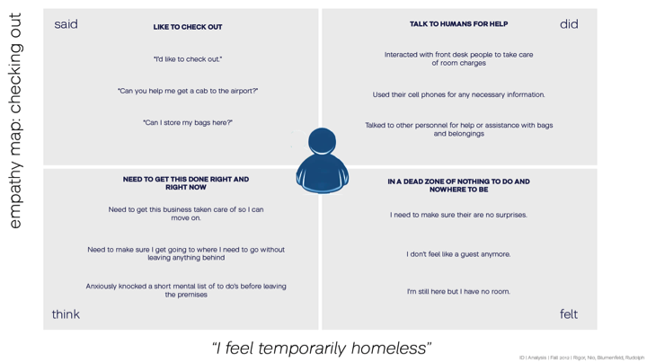
Empathy map example

Slide 5
Empathy map template
Saying
Thinking
What won’t they tell you?
Type notes here
Type notes here
Type notes here
Feeling
Doing
Type notes here
Type notes here

Slide 6
Step 3: create a user Journey
  Synopsis of approach
  This framework helps you break down and analyze existing experiences.
  The user journey outlines and identifies the different phases a customer goes through during an end-to-end service experience. Breaking an experience into discrete segments allows for more in-depth analysis (i.e. sequencing, pacing, time). Pleasure and pain moments can be overlaid onto the model to provide more subjective analysis around the overall experience and highlight what is working well, and what needs
  to be addressed.
  Client context
  KSFs
  Trying to improve an experience for a group of users
  May have a myopic view of their customer experience, the journey can help broaden their understanding.
  Trying to design services, or the planning and organizing of people, infrastructure, communication and material components of a service in order to improve its quality and the interaction between service provider and customers.
  Apply to discreet experiences, where there is a clear beginning and end
  Should leverage a fact base created during research
  Is at the right level of abstraction – concrete enough so you can solve the problem at hand but also abstract enough so that you have a large umbrella under which to have ideas
  Start and end the journey at the appropriate points – usually earlier and later than you expect

Slide 7
User journey
Participants
Process overview
Research team
Begin by framing the journey – what user will we focus on and what are the beginning and ending stages of the journey?
Next, detail the user’s experience during this journey by identifying (use a different color sticky note for each category):
  People, places, and things
  Activities
  Emotions
  Connections
Most teams prefer to work linearly, which is fine. However, keep the team moving quickly thought the experience, it is often more valuable to run through the journey several times, adding to and editing each iteration.
Assess the journey focusing on the following:
  Causality: “Why is it happening?”
  Relation: “How does it connect?”
  Significance: “Why does it matter?”
  Meaning making: “What does this mean?”
Finally, identify any opportunity spaces that results from reducing / eliminating the points of pain and from enhancing and supporting the points of pleasure.
Inputs
Notes from deep ethnographic interviews and observations
Empathy maps
Outputs
Detailed understanding of a user’s journey to use the service or complete a task
An understanding of the similarities and differences between how different groups of users complete a task
Opportunity spaces that will help create an integrated user experience
  TBD

Slide 8
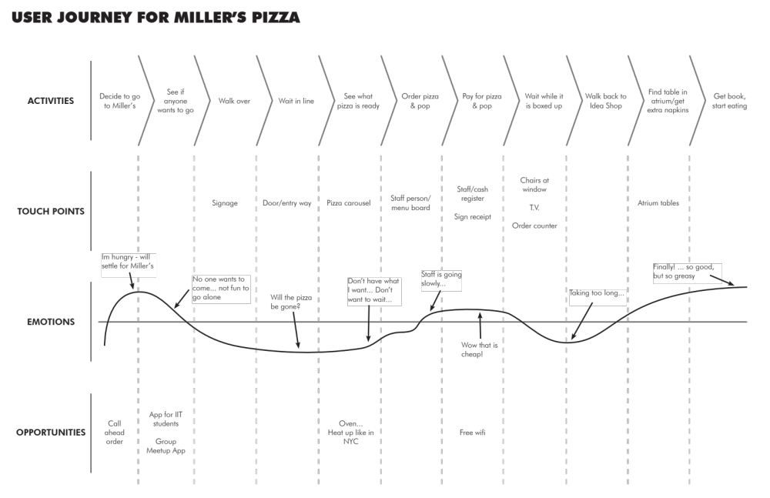
Empathy map example

Slide 9
User journey template
Activities
Touch points
Emotions
Opportunities

